Slide 1

TMW07 Conceptualizing Desired State Configuration Using Your Own Scripts
Will Anderson
Microsoft MVP/CEO
The DevOps Collective
Level: Intermediate

Slide 2
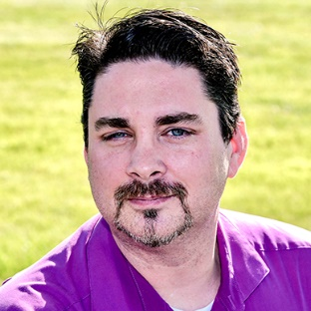
About Me
2015-2018 Microsoft MVP – Cloud and Datacenter Management
2015 Honorary Scripting Guy
CEO – The DevOps Collective
@GamerLivingWill for pretty much everything.

Slide 3
Why DSC?
Documentation
Auditable
Sustainable/Enforceable Security and Compliance
Reduce Drift

Slide 4
Bullet 1 for the slide
  Sub-bullet
  Sub bullet
Bullet 2 for the slide
  Just to see how the copy looks if it goes deep enough to reach the bottom.
    You never know how much copy will be on a slide
Bullet 3 for the slides
  This is a critical point that needs to be communicated

